Slide 1
La Nación
An integrated newsroom
Thaïs de Mendonça Jorge
Grupo Mídia Multimodal

Slide 2
Research Questions
On convergence
How a communication company "leader in the generation of content (print, digital, radio and experiential)"* deals with integration?
How does this system to "deliver content when and how audiences require”* work? How to know what audiences want?
*Expressions used in La Nación’s website

Slide 3
Research Questions
About planning
Is there a daily panorama or agenda of the topics?
At what point topics of the day are drawn? Are there multiple meetings during the day?
How the integration is accomplished between the products and platforms?
Is it possible to follow an issue from its inception to the delivery by various platforms (website, smart phone, newspaper, magazine, radio, TV)?

Slide 4
La Nación
The largest daily newspaper in Costa Rica.
100 thousand copies / day
Integration process: 2007-2011
La Nacion, El Financiero, La Teja, and monthly magazines
Investment: US $ 7 million

Slide 5
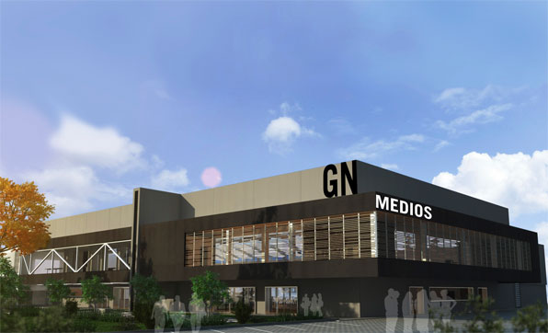
Grupo Nación

Slide 6
La Nación-Social Media
Radar and Eco: on-line edition and content distribution on the social media network and mobile devices
Team: 15 people- one chief-editor and 4 community managers.
Updating: 5 to 2:00.

Slide 7
La Nación
The journalists who work with Social Media at La Nación are journalists of a different kind: they never go to the streets, they don’t interview nor write complete reports. Do not cultivate sources, don’t have an address book. They even don’t have deadlines: the deadline is right now.
Software used: Adobe Analytics, ChartBeat, Comscore, Excel e as ferramentas do Facebook e do Twitter.

Slide 8
Media Convergence
“…a process of integration of traditionally separate modes of communication, affecting companies, technologies, professionals and audiences in all the phases of the production, distribution and consumption of contents of any type”.
Marcos Palacios/ Javier Díaz Noci

Slide 9
Inferences
The process of media convergence may cause:
Alterations in the way people consume news – social media and other phenomena;
Doubts about the news routines and the production process inside the newsrooms;
Questioning the content business model .

Slide 10
La Nación-Conclusões específicas
La Nación is counscious of the changes.
There are many iniciatives to incentivate participation of the public in the process of news production.
The Group has built a structure to integrate the newsrooms and now is trying to tropicalize the model, i.e., to adapt the traditional process to the context.
They have many doubts about the process and the business model.

Slide 11
The research - State of the Art
Paper to Latin-American Association of Investigators in Communication (ALAIC): Convergence Experiences in Brazil and Costa Rica. Analysis of the integration processes in newsrooms: the case of Correio Braziliense, O Globo and La Nación. Thaïs M. Jorge, Edgard Costa, Suzana Guedes, Benedito Medeiros.
Paper to Lusocom: Social Media Editor. The End of the Gatekeeper? Thaïs M. Jorge, Marina Simon.
Paper to International Congress on Cyberjournalism and Web 3.0. Rise and Fall of Mobile Devices: a study about Journalism in tablets in Brazil and Spain. Thaïs M. Jorge, Luisa Laval.
Paper to Brazilian Society of Journalism Researchers: News Values in a Website’s Home Page: ideology and power. Thaïs M. Jorge.

Slide 12
Muito obrigada Thank you thaisdemendonca@gmail.com

